Slide 1
STOR 455 Class 35
Read: 5.1-5.4, 5.7, 8.2
Exercises: 5.27, 37, 38, 40, 45, 47, 62, 64

Slide 2
ANOVA for Difference in K Means
Data: Samples from K different groups
Summary statistics:
For each group
Combine all
Test: H_{o}: μ₁ = μ₂=...= μ_{K}
H_{a}: Some μ_{i} ≠μ_{j}

Slide 3
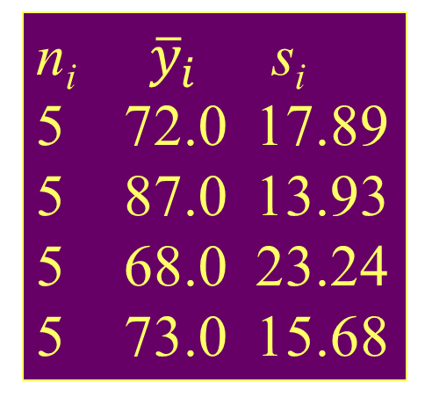
Example: Four Exams
n_{i} ${\overline{y}}_{i}$ s_{i}
5 72.0 17.89
5 87.0 13.93
5 68.0 23.24
5 73.0 15.68
Exam #1:
Exam #2:
Exam #3:
Exam #4:
62, 94, 68, 86, 50
87, 95, 93, 97, 63
74, 86, 82, 70, 28
77, 89, 73, 79, 47
Overall 20 75.0 18.11
Is there a significant difference in average grade among the four exams?
Test: H_{o}: μ₁ = μ₂= μ₃ = μ₄
H_{a}: Some μ_{i} ≠μ_{j}

Slide 4
Partitioning Variability
=
+
Data
Model
Error
Y
=
μ_{i}
+
ε
=
+
TOTAL variation in response, Y
Variation explained by MODEL
Unexplained variation in RESIDUALS
Key question: Does the MODEL explain a “significant” amount of the TOTAL variability?

Slide 5
Partitioning Variability ANOVA for Group Means
Y
=
μ_{k}
+
ε
=
+
?
=
+
=
SSGroups
+
SSE
SSTotal

Slide 6
ANOVA Output in R
amodG=aov(Grade~factor(Exam),data=Exams4)
amodG
Call:
aov(formula = Grade ~ factor(Exam), data=Exams4)
Terms:
factor(Exam) Residuals
Sum of Squares 1030 5200
Deg. of Freedom 3 16
Residual standard error: 18.02776
Estimated effects may be unbalanced
summary(amodG)
Df Sum Sq Mean Sq F value Pr(>F)
factor(Exam) 3 1030.0 343.3 1.0564 0.395
Residuals 16 5200.0 325.0

Slide 7
Checking Conditions for ANOVA
Check with residuals
Zero mean:
Always holds for sample residuals
Constant variance:
Plot residuals vs. fits and/or compare std. dev.’s of groups (Check if some group s_{i} is more than twice another).
Normality:
Histogram/normal plot of residuals
Independence:
Pay attention to data collection

Slide 8
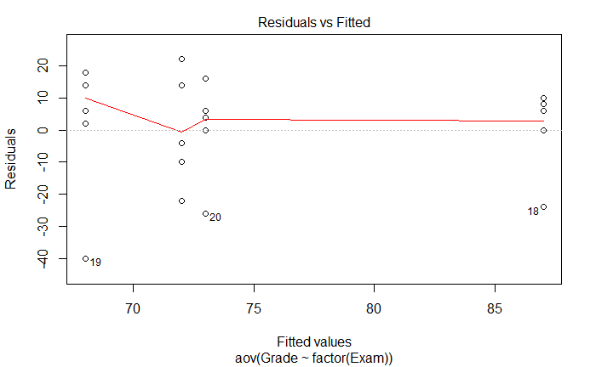
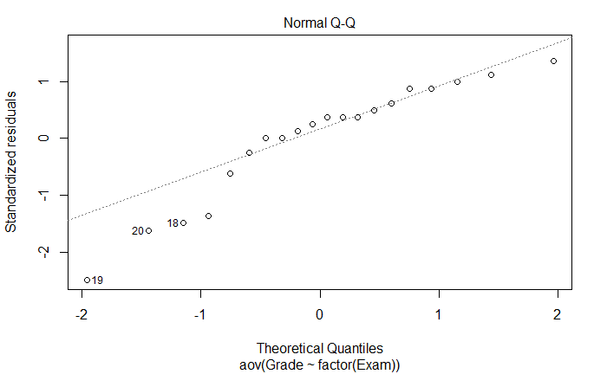
Residual Plots – Exam ANOVA
plot(amodG)
Might be a problem in this tail?

Slide 9
Example: Five Students
Barb Betsy Bill Bob Bud
Exam #1:
Exam #2:
Exam #3:
Exam #4:
62 94 68 86 50
87 95 93 97 63
74 86 82 70 28
77 89 73 79 47
Mean 75.0 91.0 79.0 83.0 47.0
Is there a significant difference in average grade among the five students?

Slide 10
ANOVA for Grades vs. Students
> tapply(Exams4$Grade,Exams4$Student,mean)
Barb Betsy Bill Bob Bud
75 91 79 83 47
> round(tapply(Exams4$Grade,Exams4$Student,sd),2)
Barb Betsy Bill Bob Bud
10.30 4.24 10.98 11.40 14.45
> modS=aov(Grade~factor(Student),data=Exams4)
> summary(modS)
Df Sum Sq Mean Sq F value Pr(>F)
Student 4 4480 1120.0 9.6 0.000468 ***
Residuals 15 1750 116.7
There is a significant difference in mean exam score between the students.
Which means are significantly different?

Slide 11
How Many Comparisons?
Example: Barb, Betsy, Bill, Bob, Bud (5 groups)
Barb vs. Betsy Barb vs. Bill Barb vs. Bob
Barb vs. Bud Betsy vs. Bill Betsy vs. Bob
Betsy vs. Bud Bill vs. Bob Bill vs. Bud
Bob vs. Bud
⇒ 10 possible comparisons

Slide 12
Problem of Multiplicity
When doing many pairwise comparisons
⇒ likely to make a Type I error (find a false difference)
Possible fixes:
Do only a few pre-planned comparisons
Adjust the significance level used for each test.

Slide 13
Pairwise Comparisons AFTER ANOVA
Compute a CI for μ_{i}− μ_{j}
Pairwise t-tests for difference in means
H_{o}: μ_{i} = μ_{j} vs. H_{a}: μ_{i} ≠ μ_{j}
Use the “usual” procedures except:
(a) Estimate any σ with
(b) Use the error d.f. for any t-values

Slide 14

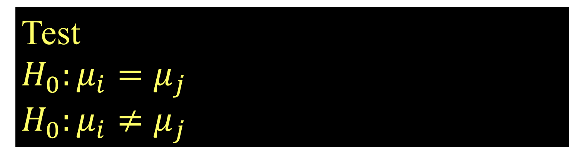
Pairwise Inference After ANOVA
CI for
$$μ_{i}−μ_{j}$$
(use error d.f.)
Test
$$H_{0}:μ_{i}=μ_{j}$$
$$H_{0}:μ_{i}≠μ_{j}$$

Slide 15
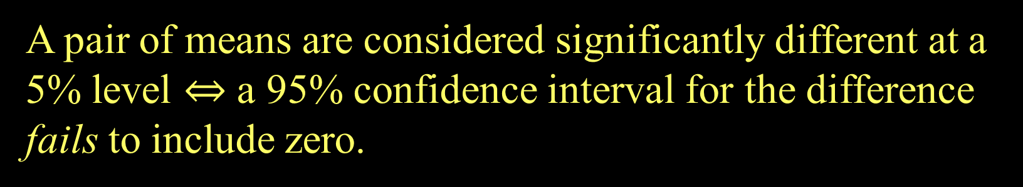
Confidence Intervals and Tests
A pair of means are considered significantly different at a 5% level $⇔$ a 95% confidence interval for the difference fails to include zero.

Slide 16
Fisher’s LSD (Least Significant Difference)
Conclude μ_{i} differs from μ_{j} ⇔

Slide 17

ANOVA for Grades vs. Students
> tapply(Exams4$Grade,Exams4$Student,mean)
Barb Betsy Bill Bob Bud
75 91 79 83 47
> mod2=aov(Grade~Student,data-Exams4)
> summary(mod2)
Df Sum Sq Mean Sq F value Pr(>F)
Student 4 4480 1120.00 9.6 0.0004676 ***
Residuals 15 1750 116.67
Bud’s mean grade is sig. different from the other four.
There is a significant difference in mean exam score between the students.
$$LSD=2.132\sqrt{116.67}\sqrt{\frac{1}{4}+\frac{1}{4}}=16.3$$

Slide 18
Problem of Multiplicity
When doing many pairwise comparisons ⇒ likely to make a Type I error (find a false difference)
⇒ Fisher’s LSD may be too lenient (liberal)
Possible fixes:
Do only a few pre-planned comparisons
Use a smaller α for each test.
Bonferroni adjustment: When doing m tests with a overall error rate of α*, use α ≈ α*/m for each test.

Slide 19

ANOVA for Grades vs. Students
> tapply(Exams4$Grade,Exams4$Student,mean)
Barb Betsy Bill Bob Bud
75 91 79 83 47
> mod2=aov(Grade~Student,data-Exams4)
> summary(mod2)
Df Sum Sq Mean Sq F value Pr(>F)
Student 4 4480 1120.00 9.6 0.0004676 ***
Residuals 15 1750 116.67
Bud’s mean grade is sig. different from the other four.
10 comparisons ⇒ use $α=\frac{0.05}{10}=0.005$ for each test
$$BSD=3.286\sqrt{116.67}\sqrt{\frac{1}{4}+\frac{1}{4}}=25.1$$
t* for 99.5%

Slide 20
Tukey’s HSD (Honestly Significant Difference)
Replace t* with a value q* from the studentized range distribution (use R).
Depends on α, # groups=K, and error d.f.
R: use qtukey(1-α, K, n-K)

Slide 21

ANOVA for Grades vs. Students
> tapply(Exams4$Grade,Exams4$Student,mean)
Barb Betsy Bill Bob Bud
75 91 79 83 47
> mod2=aov(Grade~Student,data-Exams4)
> summary(mod2)
Df Sum Sq Mean Sq F value Pr(>F)
Student 4 4480 1120.00 9.6 0.0004676 ***
Residuals 15 1750 116.67
> qtukey(1-0.05,5,15)
4.366985
Bud’s mean grade is sig. different from the other four.
$$HSD=\frac{4.37}{\sqrt{2}}\sqrt{116.67}\sqrt{\frac{1}{4}+\frac{1}{4}}=23.6$$

Slide 22
LSD and BSD in R
#To get pairwise tests using Fisher's LSD
> pairwise.t.test(Exams4$Grade,Exams4$Student,p.adj="none")
Barb Betsy Bill Bob
Betsy 0.05357 - - -
Bill 0.60812 0.13699 - -
Bob 0.31148 0.31148 0.60812 -
Bud 0.00229 3.8e-05 0.00079 0.00028
P value adjustment method: none
#To get pairwise tests using Bonferroni
> pairwise.t.test(Exams4$Grade,Exams4$Student,p.adj="bonf")
Barb Betsy Bill Bob
Betsy 0.53567 - - -
Bill 1.00000 1.00000 - -
Bob 1.00000 1.00000 1.00000 -
Bud 0.02293 0.00038 0.00789 0.00277
P value adjustment method: bonferroni
Small p-value ⇒ different group means

Slide 23
Tukey HSD via R
> TukeyHSD(modS)
Tukey multiple comparisons of means
95% family-wise confidence level
Fit: aov(formula = Grade ~ Student)
$Student
diff lwr upr p adj
Betsy-Barb 16 -7.584413 39.584413 0.2720310
Bill-Barb 4 -19.584413 27.584413 0.9835150
Bob-Barb 8 -15.584413 31.584413 0.8295529
Bud-Barb -28 -51.584413 -4.415587 0.0166293
Bill-Betsy -12 -35.584413 11.584413 0.5360462
Bob-Betsy -8 -31.584413 15.584413 0.8295529
Bud-Betsy -44 -67.584413 -20.415587 0.0003116
Bob-Bill 4 -19.584413 27.584413 0.9835150
Bud-Bill -32 -55.584413 -8.415587 0.0060225
Bud-Bob -36 -59.584413 -12.415587 0.0021941

Slide 24
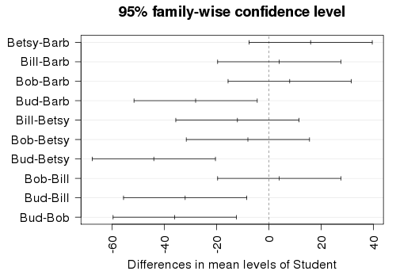
origpar=par() #saves current graphic parameters par(mar=c(4,7,3,1)) #adjusts margins for wider labels hsd=TukeyHSD(modS) #save the Tukey intervals plot(hsd,las=2) #plot the intervals
par(origpar) #restore graph settings

Slide 25
Example: Exam Scores
Barb Betsy Bill Bob Bud
Mean
72
87
68
73
75
Exam #1:
Exam #2:
Exam #3:
Exam #4:
62 94 68 86 50
87 95 93 97 63
74 86 82 70 28
77 89 73 79 47
Mean 75 91 79 83 47
We’ve shown (one-way):
No significant differences between the exams
Significant differences between the students
Question: Can we use BOTH factors to help explain the variability in the exam scores?

Slide 26
The Diet data set contains information on 78 people using one of three diets
Variable name | Variable
Person | Participant number
Sex | 1 = male, 0 = female
Age | Age (years)
Height | Height (cm)
preweight | Weight before the diet (kg)
Diet | Diet label (1, 2, or 3)
weight6weeks | Weight after 6 weeks (kg)
Investigate the data to determine the impact of the type of diet and sex on mean weight loss in separate models.
Evaluate the residuals for the appropriateness of using the ANOVA model in each model
Use pairwise methods to investigate differences between means if the overall ANOVA model is significant.

